Slide 1
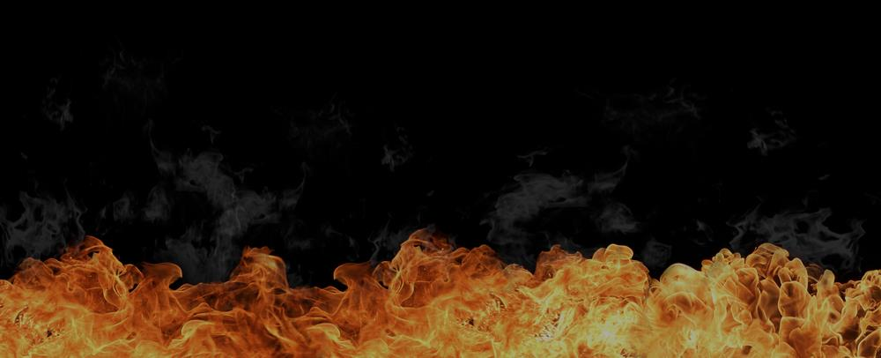


If an Almighty God decides, for whatever reason, to put you in Hell, you won’t be able to stop Him. So, you should...
Revelation 19:15 And out of his mouth goeth a sharp sword, that with it he should smite the nations: and he shall rule them with a rod of iron: and he treadeth the winepress of the fierceness and wrath of Almighty God.
Isaiah 13:6 Howl ye; for the day of the LORD is at hand; it shall come as a destruction from the Almighty.
fear him which is able to destroy both soul and body in hell.
Proverbs 9:10 The fear of the LORD is the beginning of wisdom: and the knowledge of the holy is understanding.
Psalm 119:119 Thou puttest away all the wicked of the earth like dross: ...120 My flesh trembleth for fear of thee; and I am afraid of thy judgments.
Matthew 10:28
Matthew 13:41 The Son of man shall send forth his angels, and they shall gather out of his kingdom all things that offend, and them which do iniquity; 42 And shall cast them into a furnace of fire: there shall be wailing and gnashing of teeth.
Matthew 25:41 Then shall he say also unto them on the left hand, Depart from me, ye cursed, into everlasting fire, prepared for the devil and his angels:
2Thessalonians 1:8 In flaming fire taking vengeance on them that know not God, and that obey not the gospel of our Lord Jesus Christ: 9 Who shall be punished with everlasting destruction from the presence of the Lord, and from the glory of his power;
Matthew 25:46 And these shall go away into everlasting punishment: but the righteous into life eternal.
2 quick questions if I may, please…
Q1:
Can you explain to me your need for righteousness?
It’s a tough question, I know. Stay with me here,
you’re about to learn the correct answer: God’s answer!
If you were to live the rest of your life as a serial killer
could that possibly hurt your chances of going to Heaven?
Q2:

Slide 2
Many will beg and plead with God on Judgment Day. Jesus said:
Many will say to me in that day,
Lord, Lord, have we not … in thy name
done many wonderful works?
Matthew 24:11 And many false prophets shall rise, and shall deceive many.
Matthew 7:13 Enter ye in at the strait gate: for wide is the gate, and broad is the way, that leadeth to destruction, and many there be which go in thereat: 14 Because strait is the gate, and narrow is the way, which leadeth unto life, and few there be that find it.
Matthew 7:22
“I was pretty good”
John 12:47 And if any man hear my words, and believe not, I judge him not: for I came not to judge the world, but to save the world. 48 He that rejecteth me, and receiveth not my words, hath one that judgeth him: the word that I have spoken, the same shall judge him in the last day. 49 For I have not spoken of myself; but the Father which sent me, he gave me a commandment, what I should say, and what I should speak.
I loved my fellow man
I taught Sunday School
I gave lots to charity
My dad was a pastor
I was baptized
I followed the golden rule
“I never killed anyone”
All religions are the same
I kept the 10 commandments
I built churches, houses and hospitals
Matthew 7:22 Many will say to me in that day, Lord, Lord, have we not prophesied in thy name? and in thy name have cast out devils? and in thy name done many wonderful works? 23 And then will I profess unto them, I never knew you: depart from me, ye that work iniquity.
Matthew 25:41 Then shall he say also unto them on the left hand, Depart from me, ye cursed, into everlasting fire, prepared for the devil and his angels:
I adopted poor children
“I believed in Jesus”
I fought for equality and justice
I asked you into my heart
I did everything my religion told me to
I was a deacon
I am an atheist
“I went to church” … blah, blah, blah
How exactly will Jesus answer every time?

Slide 3
Jesus will answer:
I never knew you: depart from me,
ye that work iniquity…into everlasting fire
Matthew 7:23
+Matthew 25:41
He says that they “work iniquity”. Why? Because…
Every work that they’ve ever done is:
sin!
iniquity...

Slide 4

The Bible says: their works are works of iniquity
... all our righteousnesses are as filthy rags,
... there is none that doeth good, no, not one.
Isaiah 57:12 I will declare thy righteousness, and thy works; for they shall not profit thee.
Isaiah 59:6 Their webs shall not become garments, neither shall they cover themselves with their works: their works are works of iniquity, ...
Matthew 23:5 But all their works they do for to be seen of men:
Jeremiah 25:7 Yet ye have not hearkened unto me, saith the LORD; that ye might provoke me to anger with the works of your hands to your own hurt.
2 Kings 22:17 Because they have forsaken me, and have burned incense unto other gods, that they might provoke me to anger with all the works of their hands; therefore my wrath shall be kindled against this place, and shall not be quenched.
Jeremiah 32:30-31 For the children of Israel and the children of Judah have only done evil before me from their youth: for the children of Israel have only provoked me to anger with the work of their hands, saith the LORD. 31 For this city hath been to me as a provocation of mine anger and of my fury from the day that they built it even unto this day; that I should remove it from before my face,
Ecclesiastes 1:14 I have seen all the works that are done under the sun; and, behold, all is vanity and vexation of spirit.
Isaiah 41:24-29 Behold, ye are of nothing, and your work of nought: an abomination is he that chooseth you. … 28 For I beheld, and there was no man; even among them, ... 29 Behold, they are all vanity; their works are nothing: ...
Isaiah 59:6, Isaiah 64:6, Psalms 53:3, Romans 3:12
All your works, not just your sins, are filthy to God.

Slide 5

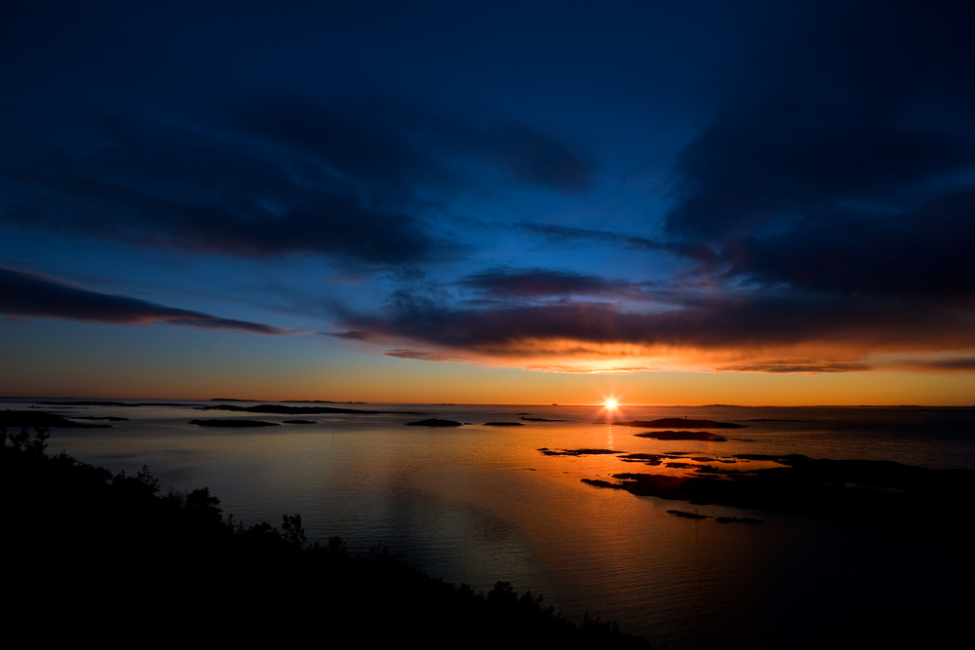

They believed in God. But they also thought they had to do:
...many wonderful works.
Matthew 7:22 Many will say to me in that day, Lord, Lord, have we not prophesied in thy name? and in thy name have cast out devils? and in thy name done many wonderful works? 23 And then will I profess unto them, I never knew you: depart from me, ye that work iniquity.
Jeremiah 48:7 For because thou hast trusted in thy works and in thy treasures, thou shalt also be taken: ...
Jeremiah 25:7 Yet ye have not hearkened unto me, saith the LORD; that ye might provoke me to anger with the works of your hands to your own hurt.
2 Kings 22:17 Because they have forsaken me, and have burned incense unto other gods, that they might provoke me to anger with all the works of their hands; therefore my wrath shall be kindled against this place, and shall not be quenched.
Galatians 2:16 Knowing that a man is not justified by the works of the law, but by the faith of Jesus Christ, even we have believed in Jesus Christ, that we might be justified by the faith of Christ, and not by the works of the law: for by the works of the law shall no flesh be justified.
Romans 3:28 Therefore we conclude that a man is justified by faith without the deeds of the law.
Romans 4:6 Even as David also describeth the blessedness of the man, unto whom God imputeth righteousness without works,
Matthew 7:22
They never stopped trusting in their works!
They believed…
Be
Good
Be
Bad
HEAVEN
HELL
go to
go to
Lie
That keeps people out of Heaven. So, if...
thou hast trusted in thy works ...
thou shalt also be taken [and] cast into hell;
Jeremiah 48:7
Luke 12:5

Slide 6
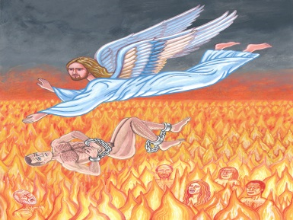
The Book of Revelation says:
there shall in no wise enter into [Heaven]
any thing that … maketh a .
Lie
Psalms 58:3 The wicked are estranged from the womb: they go astray as soon as they be born, speaking lies.
Isaiah 59:4 None calleth for justice, nor any pleadeth for truth: they trust in vanity, and speak lies; they conceive mischief, and bring forth iniquity.
Job 15:35 They conceive mischief, and bring forth vanity, and their belly prepareth deceit.
Revelation 21:27
Lie
And you certainly can make a . So...
Proverbs 19:5 A false witness shall not be unpunished, and he that speaketh lies shall not escape. Proverbs 19:9 ... he that speaketh lies shall perish.
Psalm 101:7 He that worketh deceit shall not dwell within my house: he that telleth lies shall not tarry in my sight.
Isaiah 63:8 For he said, Surely they are my people, children that will not lie: so he was their Saviour.
Proverbs 14:5 A faithful witness will not lie: but a false witness will utter lies.
Psalm 89:37 It shall be established for ever as the moon, and as a faithful witness in heaven. Selah.
Revelation 22:14 Blessed are they that do his commandments, that they may have right to the tree of life, and may enter in through the gates into the city. 15 For without are dogs, and sorcerers, and whoremongers, and murderers, and idolaters, and whosoever loveth and maketh a lie.
That’s you!
Lie
Unless it’s completely impossible for you to .
All liars
, shall have their part in the
lake which burneth with fire and brimstone
Revelation 21:8

Slide 7







No matter how hard we try, the Bible says we...
… cannot cease from sin;
Matthew 7:22 Many will say to me in that day, Lord, Lord, have we not prophesied in thy name? and in thy name have cast out devils? and in thy name done many wonderful works? 23 And then will I profess unto them, I never knew you: depart from me, ye that work iniquity.
Jeremiah 48:7 For because thou hast trusted in thy works and in thy treasures, thou shalt also be taken: ...
Isaiah 59:6 Their webs shall not become garments, neither shall they cover themselves with their works: their works are works of iniquity, and the act of violence is in their hands.
Romans 10:2 For I bear them record that they have a zeal of God, but not according to knowledge. 3 For they being ignorant of God's righteousness, and going about to establish their own righteousness, have not submitted themselves unto the righteousness of God.
Jeremiah 25:7 Yet ye have not hearkened unto me, saith the LORD; that ye might provoke me to anger with the works of your hands to your own hurt.
Matthew 24:11 And many false prophets shall rise, and shall deceive many.
Matthew 7:13 Enter ye in at the strait gate: for wide is the gate, and broad is the way, that leadeth to destruction, and many there be which go in thereat: 14 Because strait is the gate, and narrow is the way, which leadeth unto life, and few there be that find it.
2 Peter 2:14
Yet many are trying desperately to please God
with their works !
e
=mc²
The Bible says …
They have a zeal of God,
But not … knowledge
Romans 10:2
Notes:
Ignorant doesn’t mean dumb or stupid – it just means you’ve never been taught. I’m ignorant about many things.

Slide 8
For they being ignorant of
and going about to establish
have not submitted themselves unto
Romans 10:3
God’s righteousness
their own righteousness
the righteousness of God
Remember when I asked you about …
“your need for righteousness”?
Unless you answered “I need God’s righteousness ”, you are...
ignorant of God’s Righteousness.

Slide 9

And remember when I asked you about being a…
serial killer ?
If you answered, “yes, it could hurt my chances”,
or even, “I’m not sure”, then you are…
working to establish your own righteousness

Slide 10
Those who are:
Romans 10:2-4 For I bear them record that they have a zeal of God, but not according to knowledge. 3 For they being ignorant of God's righteousness, and going about to establish their own righteousness, have not submitted themselves unto the righteousness of God. 4 For Christ is the end of the law for righteousness to every one that believeth.
Romans 9:31-33 But Israel, which followed after the law of righteousness, hath not attained to the law of righteousness. 32 Wherefore? Because they sought it not by faith, but as it were by the works of the law. For they stumbled at that stumblingstone; 33 As it is written, Behold, I lay in Sion a stumblingstone and rock of offence: and whosoever believeth on him shall not be ashamed.
Philippians 3:7-9 But what things were gain to me, those I counted loss for Christ. 8 Yea doubtless, and I count all things but loss for the excellency of the knowledge of Christ Jesus my Lord: for whom I have suffered the loss of all things, and do count them but dung, that I may win Christ, 9 And be found in him, not having mine own righteousness, which is of the law, but that which is through the faith of Christ, the righteousness which is of God by faith:
1 John 5:10-12 He that believeth on the Son of God hath the witness in himself: he that believeth not God hath made him a liar; because he believeth not the record that God gave of his Son. 11 And this is the record, that God hath given to us eternal life, and this life is in his Son. 12 He that hath the Son hath life; and he that hath not the Son of God hath not life.
Matthew 24:11 And many false prophets shall rise, and shall deceive many.
1 John 4:1 Beloved, believe not every spirit, but try the spirits whether they are of God: because many false prophets are gone out into the world.
John 5:39 Search the scriptures; for in them ye think ye have eternal life: and they are they which testify of me.
Romans 3:12 They are all gone out of the way, they are together become unprofitable; there is none that doeth good, no, not one.
Matthew 7:22-23 Many will say to me in that day, Lord, Lord, have we not prophesied in thy name? and in thy name have cast out devils? and in thy name done many wonderful works? 23 And then will I profess unto them, I never knew you: depart from me, ye that work iniquity.
Isaiah 44:18 They have not known nor understood: for he hath shut their eyes, that they cannot see; and their hearts, that they cannot understand.
2 Thessalonians 2:10-12 And with all deceivableness of unrighteousness in them that perish; because they received not the love of the truth, that they might be saved. 11 And for this cause God shall send them strong delusion, that they should believe a lie: 12 That they all might be damned who believed not the truth, but had pleasure in unrighteousness.
ignorant of God’s Righteousness
✓
... and ...
✓
working to establish
their own righteousness
have not submitted themselves unto
Romans 10:3
the righteousness of God
This is why many think they’re saved, but they’re not.

Slide 11
Liar
There is only one way to stop being a .
Habakkuk 2:18 What profiteth the graven image that the maker thereof hath graven it; the molten image, and a teacher of lies, that the maker of his work trusteth therein, to make dumb idols?
Every “god” of mankind is a “teacher of lies”, who teaches men to trust in the works of their own hands.
1 Chronicles 16:26 For all the gods of the people are idols: but the LORD made the heavens. Psalms 96:5 For all the gods of the nations are idols: but the LORD made the heavens.
Isaiah 2:8 Their land also is full of idols; they worship the work of their own hands, that which their own fingers have made:
Psalms 115:4 Their idols are silver and gold, the work of men's hands.
Psalms 135:15 The idols of the heathen are silver and gold, the work of men's hands.
Acts 7:41 And they made a calf in those days, and offered sacrifice unto the idol, and rejoiced in the works of their own hands.
Revelation 9:20 And the rest of the men which were not killed by these plagues yet repented not of the works of their hands, that they should not worship devils, and idols of gold, and silver, and brass, and stone, and of wood: ...
Isaiah 44:17 And the residue thereof he maketh a god, even his graven image: he falleth down unto it, and worshippeth it, and prayeth unto it, and saith, Deliver me; for thou art my god.
1 John 5:10-12 He that believeth on the Son of God hath the witness in himself: he that believeth not God hath made him a liar; because he believeth not the record that God gave of his Son. 11 And this is the record, that God hath given to us eternal life, and this life is in his Son. 12 He that hath the Son hath life; and he that hath not the Son of God hath not life.
1 John 3:9 Whosoever is born of God doth not commit sin; for his seed remaineth in him: and he cannot sin, because he is born of God.
Isaiah 63:8 For he said, Surely they are my people, children that will not lie: so he was their Saviour.
Heb. 2:3 How shall we escape, if we neglect so great salvation; which at the first began to be spoken by the Lord, and was confirmed unto us by them that heard him;
John 14:6 Jesus saith unto him, I am the way, the truth, and the life: no man cometh unto the Father, but by me.
Matt. 7:13-14 Enter ye in at the strait gate: for wide is the gate, and broad is the way, that leadeth to destruction, and many there be which go in thereat: 14 Because strait is the gate, and narrow is the way, which leadeth unto life, and few there be that find it.
Ephesians 2:11-12 Wherefore remember, that ye being in time past Gentiles in the flesh, ... 12 That at that time ye were without Christ, being aliens from the commonwealth of Israel, and strangers from the covenants of promise, having no hope, and without God in the world:
There is only one way to “cease from sin”.
You need
God’s righteousness
not
your own righteousness
All the world’s religions only teach people how to...
establish their own righteousness
Romans 10:3
They all teach… some belief system
works!
e
=mc²

Slide 12
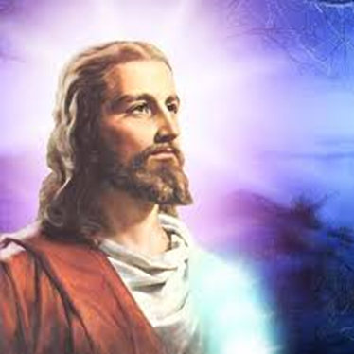
Since Jesus is... God…manifest in the flesh
And it is… impossible for God to lie...
Hebrews 6:18
Luke 1:35 And the angel answered and said unto her, ... that holy thing which shall be born of thee shall be called the Son of God.
1 John 3:9 Whosoever is born of God doth not commit sin; for his seed remaineth in him: and he cannot sin, because he is born of God.
Titus 1:2 In hope of eternal life, which God, that cannot lie, promised…
1 Samuel 15:29 And also the Strength of Israel will not lie nor repent: for he is not a man, that he should repent. Hebrews 6:18 ... it was impossible for God to lie, ...
James 1:13 …God cannot be tempted with evil, neither tempteth he any man:
Hebrews 4:15 For we have not an high priest which cannot be touched with the feeling of our infirmities; but was in all points tempted like as we are, yet without sin.
Luke 4:2 Being forty days tempted of the devil. John 8:6 This they said, tempting him,
Jesus was “tempted” by any tempter who made an offer (Satan or the Pharisees). Jesus could NOT be “tempted” to take those offers for even a moment. He CANNOT lie and CANNOT sin and CANNOT be ENTICED to do so.
James 1:14 But every man is tempted, when he is drawn away of his own lust, and enticed.
Jesus was never ENTICED at all. He NEVER had “his own lust”. They TEMPTED HIM but He could NOT BE TEMPTED.
1 Peter 2:21 For even hereunto were ye called: because Christ also suffered for us, ... 22 Who did no sin, neither was guile found in his mouth:
1 Timothy 3:16
Jesus has...
The Impossibility of Sin
Jesus is...
God’s Righteousness
Since it was completely impossible for Jesus to sin...
[God] hath made him…who knew no sin ...
2 Corinthians 5:21

Slide 13



For he hath made him .... to be sin for us,
Why? So … that we might be made
the righteousness of God in him.
Romans 3:22 Even the righteousness of God which is by faith of Jesus Christ unto all and upon all them that believe: for there is no difference:
Romans 10:4 For Christ is the end of the law for righteousness to every one that believeth.
Acts 4:12 Neither is there salvation in any other: for there is none other name under heaven given among men, whereby we must be saved. 1 John 5:12 He that hath the Son hath life; and he that hath not the Son of God hath not life.
Psalms 96:5 For all the gods of the nations are idols: but the LORD made the heavens. 1 Corinthians 8:4 ... there is none other God but one.
Jeremiah 10:11 ... The gods that have not made the heavens and the earth, even they shall perish from the earth, and from under these heavens.
Isaiah 45:5 I am the LORD, and there is none else, there is no God beside me: ...
2 Kings 5:15 ... Behold, now I know that there is no God in all the earth, but in Israel:
1 Timothy 3:16 ... God was manifest in the flesh, ...
John 1:1-14 In the beginning was the Word, and the Word was with God, and the Word was God. ... All things were made by him; and without him was not any thing made that was made. ... And the Word was made flesh, and dwelt among us, ...
John 8:58 Jesus said...Before Abraham was, I am. ... John 10:30 I and my Father are one. 31 Then the Jews took up stones again to stone him. ... saying, For a good work we stone thee not; but ... because that thou, being a man, makest thyself God.
2 Corinthians 5:21
Impossibility of sin!
God’s Righteousness
gives us…
Righteousness
Impossibility of sin!
Liar!
No one but Jesus can give you the
impossibility of sin!

Slide 14


When the righteousness of God is given, it is placed:
within you ... that the spirit may be saved
John 3:3 Jesus answered and said unto him, Verily, verily, I say unto thee, Except a man be born again, he cannot see the kingdom of God.
John 3:7 Marvel not that I said unto thee, Ye must be born again. John 3:6 That which is born of the flesh is flesh; and that which is born of the Spirit is spirit.
1 John 2:29 If ye know that he is righteous, ye know that every one that doeth righteousness is born of him.
1 John 3:7 Little children, let no man deceive you: he that doeth righteousness is righteous, even as he is righteous.
1 John 3:9 Whosoever is born of God doth not commit sin; for his seed remaineth in him: and he cannot sin, because he is born of God.
1 John 5:17-18 All unrighteousness is sin: … 18 We know that whosoever is born of God sinneth not; but he that is begotten of God keepeth himself, and that wicked one toucheth him not.
1 Peter 1:23 Being born again, not of corruptible seed, but of incorruptible, by the word of God, which liveth and abideth for ever.
John 1:12-13 But as many as received him, to them gave he power to become the sons of God, even to them that believe on his name: 13 Which were born, not of blood, nor of the will of the flesh, nor of the will of man, but of God.
Philippians 3:3 For we are the circumcision, which worship God in the spirit, and rejoice in Christ Jesus, and have no confidence in the flesh.
Luke 17:21
1 Corinthians 5:5
Until the resurrection, the impossibility of sin ...
is not given to the flesh…
…but only to the
spirit.
When a person is given the impossibility of sin :
It is the spirit that...cannot sin
but...the flesh profiteth nothing
John 6:63
1 John 3:9
Mark 14:38

Slide 15


… of this ignorance [ignorance of God’s righteousness]
God …now commandeth all men ...
to repent :
Luke 13:3 I tell you, Nay: but, except ye repent, ye shall all likewise perish. Luke 13:5 I tell you, Nay: but, except ye repent, ye shall all likewise perish.
1Samuel 15:35 …Samuel mourned for Saul: and the LORD repented that he had made Saul king over Israel.
(What did God DO? What ACT did He PERFORM? What TURN did He MAKE?) He CHANGED NOTHING EXCEPT HIS MIND!!!
Genesis 6:6 And it repented the LORD that he had made man on the earth, and it grieved him at his heart. (God is the 1st being in the Bible to “repent”)
Jeremiah 18:7 At what instant I shall speak concerning a nation, and concerning a kingdom,…to destroy it; 8 If that nation, against whom I have pronounced, turn from their evil, I will repent of the evil that I thought to do unto them. 9 And at what instant I shall speak concerning a nation, and concerning a kingdom, to build and to plant it; 10 If it do evil in my sight, that it obey not my voice, then I will repent of the good, wherewith I said I would benefit them.
2Timothy 2:25…if God peradventure will give them repentance to the acknowledging of the truth
Revelation 2:22 Behold, I will cast…them…into great tribulation, except they repent of their deeds. Revelation 16:11 And blasphemed the God of heaven because of their pains and their sores, and repented not of their deeds. Revelation 9:20 And the rest of the men ... yet repented not of the works of their hands, ...
Acts 17:30
To Repent does not mean to change your works:
by starting to go to church and trying to live a
cleaner life. It means to change your thinking.
2 Timothy 2:25
Jeremiah 18:7-10
You need to Repent : to change your mind
From trusting at all in
To trusting only in
your righteousness
God’s righteousness
where your works
where only
Jesus
matter
- and you
matters
- and HE
can sin
cannot sin

Slide 16



If you don’t Repent of your works (not your sins)…you get no grace!
The Bible says...
if by grace, then is it no more of works:
But if [by] works, then is it no more grace
Romans 11:6 And if by grace, then is it no more of works: otherwise grace is no more grace. But if it be of works, then is it no more grace: otherwise work is no more work.
Romans 4:4-5 Now to him that worketh is the reward not reckoned of grace, but of debt. 5 But to him that worketh not, but believeth on him that justifieth the ungodly, his faith is counted for righteousness.
Galatians 5:3 For I testify again to every man that is circumcised [i.e works after conversion as proof of true conversion], that he is a debtor to do the whole law.
Romans 9:31-32 But Israel, which followed after the law of righteousness, hath not attained to the law of righteousness. 32 Wherefore? Because they sought it not by faith, but as it were by the works of the law. For they stumbled at that stumblingstone;
Hebrews 4:10 For he that is entered into his rest, he also hath ceased from his own works, as God did from his.
Galatians 2:21 I do not frustrate the grace of God: for if righteousness come by the law [works], then Christ is dead in vain.
Galatians 3:1-10 … who hath bewitched you, that ye should not obey the truth… Are ye so foolish? having begun in the Spirit, are ye now made perfect by the flesh? … For as many as are of the works of the law are under the curse: …
Ephesians 2:8-9 For by grace are ye saved through faith; … Not of works, …
Romans 3:28... a man is justified by faith without the deeds of the law.
Galatians 3:26 For ye are all the children of God by faith in Christ Jesus.
Romans 11:6
Jesus was saved by
We must be saved by
Works
ALONE
Grace
ALONE
without a drop of
without a drop of
Grace
Works
If you believe that you must maintain good works…
Christ is become of no effect unto you.
Christ shall profit you nothing …
Galatians 5:4,2
Notes:
Not one drop of grace could have been included in Jesus’ salvation – He had to be saved completely by works.
Not one drop of works could have been included in your salvation – you had to be saved completely by grace.

Slide 17


Revelation 20:15 And whosoever was not found written in the book of life was cast into the lake of fire.
Matthew 25:41 Then shall he say also unto them on the left hand, Depart from me, ye cursed, into everlasting fire, prepared for the devil and his angels:
Revelation 20:10 And the devil that deceived them was cast into the lake of fire and brimstone, where the beast and the false prophet are, and shall be tormented day and night for ever and ever.
Matthew 25:46 And these shall go away into everlasting punishment: but the righteous into life eternal.
Luke 16:22-23 And it came to pass, that the beggar died, and was carried by the angels into Abraham's bosom: the rich man also died, and was buried; 23 And in hell he lift up his eyes, being in torments, and seeth Abraham afar off, and Lazarus in his bosom.
Revelation 20:14 And death and hell were cast into the lake of fire. This is the second death.
In the Lake of Fire, you will...
Luke 16:24 ... cool my tongue; for I am tormented in this flame.
James 3:6 And the tongue is…set on fire of hell.
Ignite in unimaginable pain.
Luke 16:24
James 3:6
Psalm 73:19 ... they are utterly consumed with terrors.
Jude 1:13 ... to whom is reserved the blackness of darkness for ever.
Isaiah 60:2 ... darkness shall cover the earth, and gross darkness the people
Exodus 10:21-22 ... even darkness which may be felt.
Even your tongue will be on fire.
Be constantly terrified,
Psalm 73:19
Jude 1:13
Isaiah 60:2
Exodus 10:21-22
Revelation 14:11 And the smoke of their torment ascendeth up for ever and ever: and they have no rest day nor night, ...
Isaiah 57:20-21 But the wicked are like the troubled sea, when it cannot rest, whose waters cast up mire and dirt. 21 There is no peace, saith my God, to the wicked.
Isaiah 48:22 There is no peace, saith the LORD, unto the wicked.
Job 15:20 The wicked man travaileth with pain all his days, ...
Revelation 20:10 ... cast into the lake of fire and brimstone, ... and shall be tormented day and night for ever and ever.
in a “gross” darkness that you’ll feel.
Revelation 9:2-10 And he opened the bottomless pit; ... And there came out ... locusts upon the earth: and unto them was given power, as the scorpions of the earth have power. ... and their torment was as the torment of a scorpion, when he striketh a man ... And the shapes of the locusts were like unto horses ... on their heads were as it were crowns like gold, and their faces were as the faces of men. And they had hair as the hair of women, and their teeth were as the teeth of lions. And they had breastplates, ... and the sound of their wings was as the sound of chariots ... And they had tails like unto scorpions, and there were stings in their tails: and their power was to hurt men ...
Joel 2:3-11 A fire devoureth before them; ... The appearance of them is as the appearance of horses; and as horsemen, so shall they run. ... Before their face the people shall be much pained: ... They shall run like mighty men; ... And the LORD shall utter his voice before his army: ... for the day of the LORD is great and very terrible; and who can abide it?
Luke 16:23-24 And in hell he lift up his eyes, being in torments, and seeth Abraham afar off, and Lazarus in his bosom. 24 And he cried and said, Father Abraham, have mercy on me, and send Lazarus, that he may dip the tip of his finger in water, and cool my tongue; for I am tormented in this flame.
Be tortured relentlessly,
Revelation 9:2-10
Joel 2:3-11
Luke 16:23-24
by crazed, angry, merciless creatures.
Revelation 14:11
Isaiah 57:20-21
Isaiah 48:22
Job 15:20
Revelation 20:10
Never have one moment of rest or relief.
Psalms 112:10 The wicked shall ... melt away:
Job 25:6 ...man, that is a worm? and the son of man, which is a worm?
Psalms 22:6 But I am a worm, and no man; ...
And melt – not burn up, but slowly melt
Psalm 112:10
Job 25:6
Psalms 22:6
– down to your very core : a worm.

Slide 18
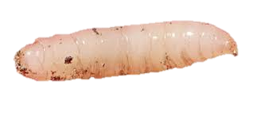
Finally, you will be…
Exodus 16:15…This is the bread which the LORD hath given you to eat.…20 notwithstanding they hearkened not unto Moses; but some of them left of it until the morning, and it bred worms, and stank: and Moses was wroth with them.
…23 And he said unto them, This is that which the LORD hath said, To morrow is the rest of the holy sabbath unto the LORD: bake that which ye will bake to day, and seethe that ye will seethe; and that which remaineth over lay up for you to be kept until the morning. 24 And they laid it up till the morning, as Moses bade: and it did not stink, neither was there any worm therein.
(spoiled food breeds maggots not worms – a maggot is a worm to God)
Isaiah 66:24 And they shall go forth, and look upon the carcases of the men that have transgressed against me: for their worm shall not die, neither shall their fire be quenched; and they shall be an abhorring unto all flesh.
Mark 9:44 Where their worm dieth not,…
A maggot
Mark 9:44
Isaiah 66:24
Exodus 16:20
trapped in a brutally cruel Lake of Fire,
to spend eternity…
Mark 14:21
Job 3:3
… wishing you had never been born.
Your greatest regret... will be this moment right now.
Mark 14:21…good were it for that man if he had never been born.
Job 3:2-3 And Job spake, and said, 3 Let the day perish wherein I was born, and the night in which it was said, There is a man child conceived.
The Bible says... It is a fearful thing to fall into the hands of the living God.
Hebrews 10:31

Slide 19
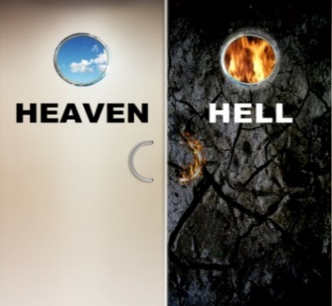
So, the final question is…
Or will you die trusting in...
your own
righteousness?
Do you want…
God’s
Righteousness?
If you want God’s righteousness, its very simple.
The Bible says...…whosoever shall call upon
the name of the Lord shall be saved.
Romans 10:13

Slide 20
You just need to sincerely pray…
Dear Lord,
Hebrews 6:1…the principles of the doctrine of Christ, let us go on unto perfection; not laying again the foundation of repentance from dead works, and of faith toward God, (If you “turn from your sins” you stop doing sins.
If you “turn from your works” you stop doing works! You must stop working! or perish!)
I REPENT OF BELIEVING IN WORKS,
I must be saved by grace, without works.
John 8:58 Jesus said unto them, Verily, verily, I say unto you, Before Abraham was, I am. 59 Then took they up stones to cast at him: John 10:30 I and my Father are one. 31 Then the Jews took up stones again to stone him. 32 Jesus answered ... Many good works have I shewed you from my Father; for which of those works do ye stone me? 33 The Jews answered him, saying, For a good work we stone thee not; but for blasphemy; and because that thou, being a man, makest thyself God.
I BELIEVE JESUS IS GOD,
The One True Almighty God.
Romans 11:18 ... thou bearest not the root [Jesus], but the root thee.
Colossians 3:3-4 For ye are dead, and your life is hid with Christ in God. 4 When Christ, who is our life, shall appear, then shall ye also appear with him in glory.
1Corinthians 15:1 Moreover, brethren, I declare unto you the gospel…2 By which also ye are saved, … 3… how that Christ died for our sins ... 4 And that he was buried, and that he rose again the third day according to the scriptures:
I BELIEVE ONLY JESUS MATTERS,
Jesus died for me, and rose again.
I SUBMIT TO GOD’S RIGHTEOUSNESS,
so I will have, the impossibility of sin.
Psalm 81:15 The haters of the LORD should have submitted themselves unto him: but their time should have endured for ever.
1John 3:10 In this the children of God are manifest, and the children of the devil: whosoever doeth not righteousness is not of God
Amen.
Would you like to pray that right now?

Slide 21
If you prayed that and you meant it…
1John 3:9 Whosoever is born of God doth not commit sin; for his seed remaineth in him: and he cannot sin, because he is born of God.
You have the IMPOSSIBILITY OF SIN
Hebrews 12:23 To the general assembly and church of the firstborn, which are written in heaven, and to God the Judge of all, and to the spirits of just men made perfect,
Your SPIRIT is 100% perfect and cannot sin
No matter what your FLESH does
Romans 8:8 So then they that are in the flesh cannot please God. 9 But ye are not in the flesh, but in the Spirit, if so be that the Spirit of God dwell in you.
You have GOD’S RIGHTEOUSNESS
Philippians 3:9 And be found in him, not having mine own righteousness, which is of the law, but that which is through the faith of Christ, the righteousness which is of God by faith:
You can NEVER lose it
John 10:28 And I give unto them eternal life; and they shall never perish, neither shall any man pluck them out of my hand.
Even if YOU become a serial killer
1John 3:5 And ye know that he was manifested to take away our sins; and in him is no sin. 1Peter 2:22 Who did no sin, neither was guile found in his mouth:
Because Jesus was NOT a serial killer!
and ONLY JESUS matters

Slide 22

Years from now, someone may ask,
“are you going to go to Heaven when you die”?
Absolutely!!
Now you can answer…
John 3:36 He that believeth on the Son hath everlasting life: 1John 5:11 And this is the record, that God hath given to us eternal life, and this life is in his Son. 12 He that hath the Son hath life; and he that hath not the Son of God hath not life.
1John 2:25 And this is the promise that he hath promised us, even eternal life.
Titus 1:2 In hope of eternal life, which God, that cannot lie, promised before the world began;
“How can you say that?” they may ask.
You can answer…
Because I have God’s Righteousness
It is impossible for me to go to Hell!

Slide 23

www.LibertyHavenBC.com/Lordswatch

